Slide 1






EXCESS REDUCER
PRODUCT TRAINING
2026

Slide 2

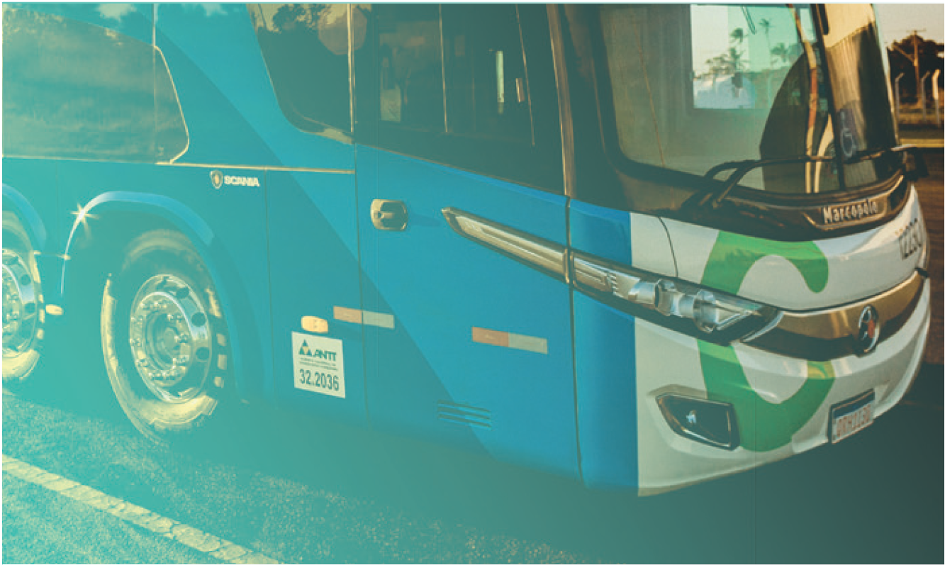


About Us
Excess Risk Consultants (Pty) Ltd was established in December 2021.
Our Excess Reducer products are underwritten by Old Mutual Insure Limited.
Our Head Office is based in Johannesburg, Gauteng and we have regional offices in Paarl, Western Cape and Mokopane, Limpopo.

Slide 3




Index
  MOTOR EXCESS REDUCERS
  Own Damage Excess Reducer 5
  Theft/Hijack Excess Reducer 7
  Third Party Excess Reducer 9
  Penalty Excess Reducers 11
  Windscreen Excess Reducer 13
  OTHER MOTOR ADD-ON PRODUCTS
  Windscreen Comprehensive Cover 14
  Commercial Roadside Assist 15
  Loss of Use 19
  Cross Border Towing & Recovery 22
  ERC Tyre Cover 23
  Credit Shortfall 25
  Car Hire 26
  GIT EXCESS REDUCERS
  Goods in Transit Basic Excess Reducer 28
  Goods in Transit Theft/Hijack Excess Reducer 30
  NON-MOTOR EXCESS REDUCER
  ERC Non-Motor Excess Reducer 32
  ERC Geyser Excess Waiver 33
  ERC Protector (Power Surge, Accidental Damage and Mechanical & Electrical Breakdown) 34
2026

Slide 4
Important Notes – Applicable to all sections
Important Notes
  All sections must always be comprehensively insured with a valid underlying policy in place.
  Minimum sections per policy: Own Damage Excess reducer + any other section.
  Minimum premium per policy: R100 per month
  Broker Commission: Non-Motor 20% & Motor 12.5%
  The Underlying Insurer must admit liability before our cover will respond, except where the claim falls within the excess. If the client’s claim falls within the excess with the Underlying Insurer, they can still submit a claim to ERC.
  Our rating guide is a guideline only and is always subject to the Policy Wording.

Slide 5
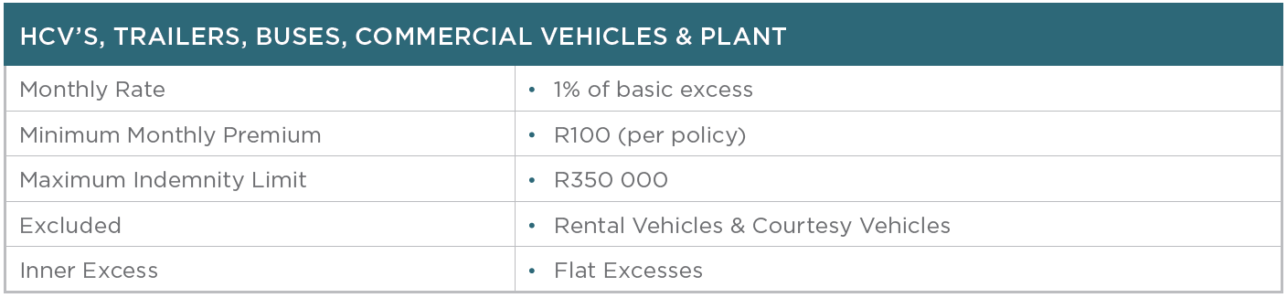
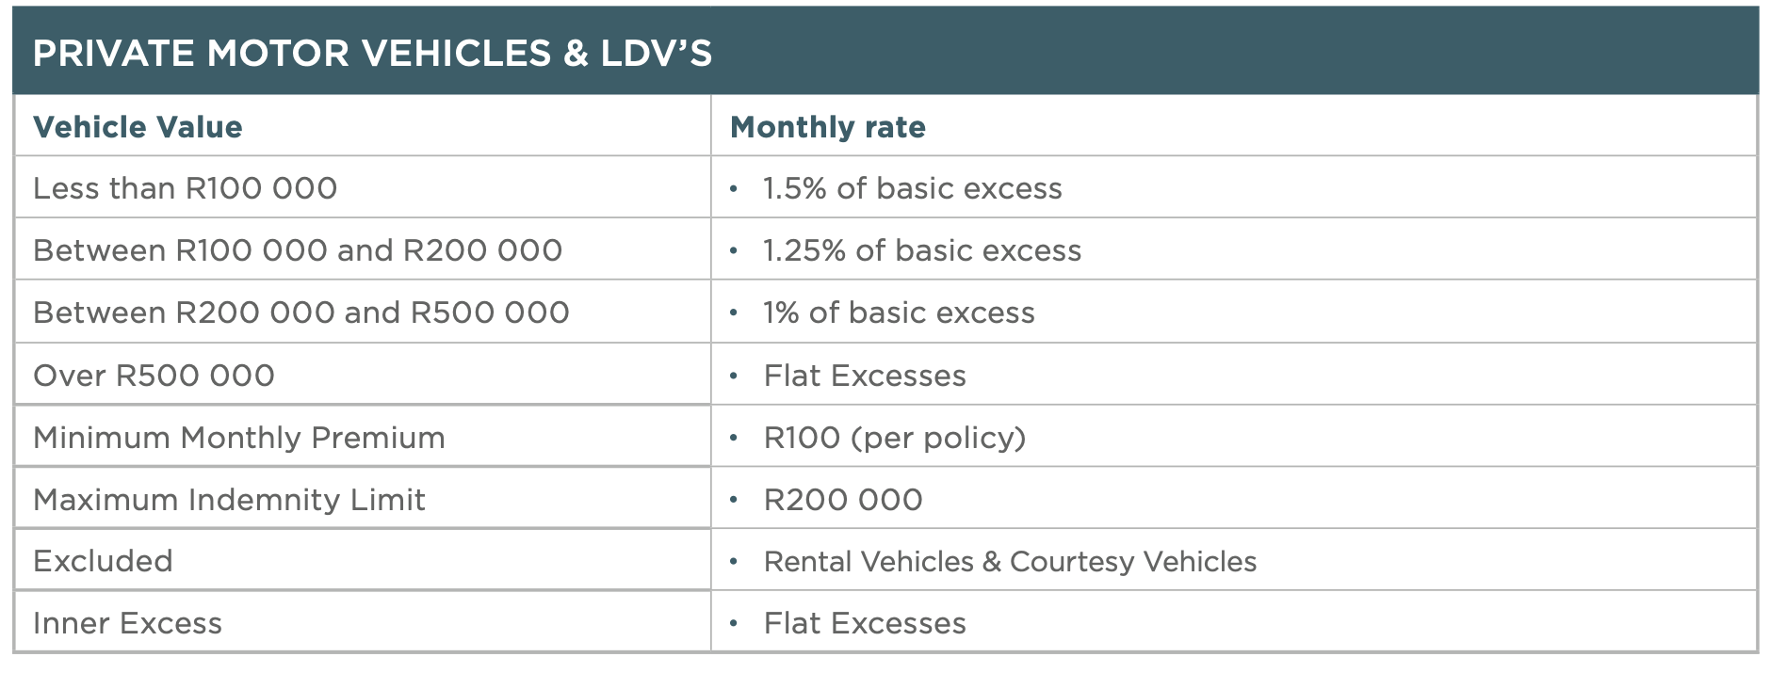
1. Own Damage Excess Reducer
  This section insures your Standard Own Damage excess which is payable in terms of your Underlying Insurance Policy limited to the Sum Insured stated in this Policy Schedule and the Maximum Sum Insured stated below.
*Inner excesses are subject to underwriting and will be determined by ERC

Slide 6
1. Own Damage Excess Reducer
Specific Conditions
1. In terms of the Insured Vehicles the policy is limited to the Sum Insured as stated subject to maximum Sum Insured per event of;
1.1. Heavy Commercial Vehicles, Trailers, Buses, Commercial Vehicles & Plant – R350 000
1.2. Private Motor Vehicles & LDV’s – R 200 000
2. Less the Inner excess as stated in the Policy Schedule and/or as noted on endorsement on Policy Schedule.
3. If non-standard excesses are applied by Underlying Insurers, inner excess may vary
Specific Exclusions
The underwriter shall not be held liable for:
1. Any loss or damage or injuries to third parties; consequential loss as a result of any cause whatsoever, depreciation in value whether arising from repairs following a defined event or otherwise wear and tear, mechanical or electrical breakdown, failures or breakages and any penalty excess not specifically purchased.
2. Towing & Recovery Costs are excluded.
3. Theft & Hijack excluded unless the policy has been extended to include Total Loss (Theft/Hijack cover)
4. Any additional excesses are excluded unless Insured and noted on Policy Schedule.

Slide 7
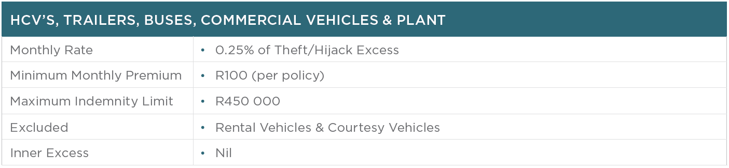

2. Theft/Hijack Excess Reducer
  This section covers your Theft/Hijack excess which is payable in terms of your Underlying Insurance Policy limited to the Sum Insured stated in the Policy Schedule or the Maximum Sum Insured stated below, subject to the applicable Inner excess (as defined).
  Theft is defined as the unlawful intentional removal of the insured vehicle without the Insureds permission.
  Hijacking is defined as the unlawful and forcible seizure, accompanied by violence or threat of violence on or against the person or persons, who at the time of the seizure was in lawful control of the insured vehicle specified in the Policy Schedule.
Important Note:
  To a vehicle stolen and recovered with damage an inner excess of R5 000 will apply unless otherwise agreed with ERC.

Slide 8
2. Theft/Hijack Excess Reducer
Specific Conditions
1. In terms of the Insured Vehicles (as defined) the policy is limited to the Sum Insured as stated subject to maximum Sum Insured per event of;
1.1 Heavy Commercial Vehicles, Trailers, Buses, Commercial Vehicles & Plant – R450 000
1.2. Private Motor Vehicles & LDV’s – R 200 000
2. Less the Inner excess as stated in the Policy Schedule and/or as noted on endorsement on Policy Schedule.
3. Any vehicle stolen and recovered with damage - an inner excess of R5 000 will apply unless otherwise agreed with ERC.
4. In the event that the Underlying Policy Insurer successfully recovers the Insured Vehicle, the Underwriter reserves the right to be reimbursed for their rateable portion of the salvage.
5. Should the vehicle be recovered with damage the client can claim under the Own Damage section of this policy if applicable.
Specific Exclusions
1. No benefit shall accrue until a period of 6 (six) consecutive weeks has elapsed from the date of the Insured Total Loss event or in the event that the Insured has not been indemnified by the Underlying Policy Insurer.

Slide 9
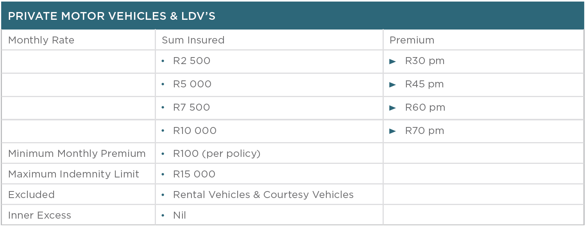
3. Third Party Excess Reducer
  This section insures you for payment of your Third-Party Liability excess which is payable in terms of your Underlying Insurance Policy limited to the maximum Sum Insured stated in this Policy Schedule.
  A liability event is defined as any accident caused by or through or in connection with any vehicle described in the Policy Schedule or in connection with the loading and/or unloading of such vehicle in respect of which the Insured and/or any passenger becomes legally liable to pay, provided the said liability on the Underlying Policy exceeds the Sum Insured stated in the Policy Schedule.

Slide 10
3. Third Party Excess Reducer
Specific Conditions
1. This policy will only respond if the Underlying Insurer requests for the section II liability excess i.e. must be a valid and entertained claim.
2. Unless otherwise stated, the liability of the company under this sub-section in respect of any one occurrence shall not exceed the limits of indemnity as stated in the schedule.
3. This section will not apply to Trailers that are not hitched to the horse at any one time unless individually specified under the policy.
Specific Exclusions
This section will only apply in respect of an excess solely applicable to the underlying Motor Liability section. (This section will not respond to a claim where there is both Motor Own Damage & TP liability and only a single excess applies to both damages)

Slide 11
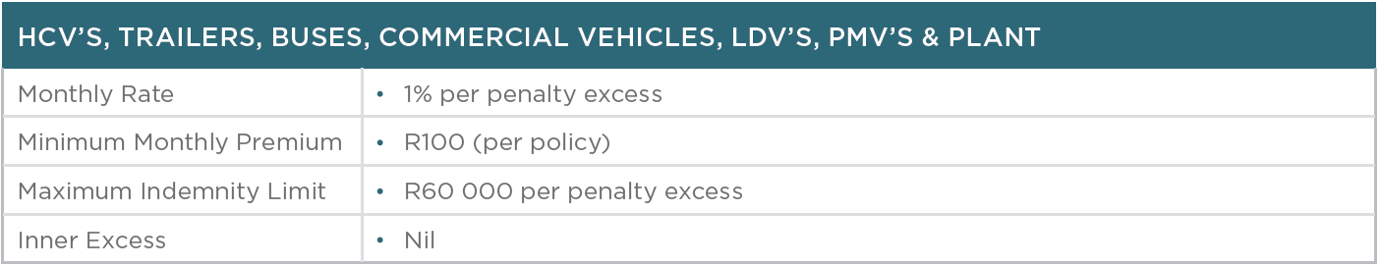
4. Penalty Excess Reducers
  This section insures your excess which is payable in terms of your Underlying Insurance Policy covering the additional penalty excesses due, limited to the Sum Insured as stated in the Policy Schedule and the Maximum Sum Insured as stated below provided the said liability on the Underlying Insurance Policy exceeds the Sum Insured stated in the Policy Schedule.
Important Notes:
  Penalty excesses capped by the Underlying Policy will be rated as above to this capped percentage amount.
  Penalty excess cover must be specified and is limited to:
  Single vehicle accident
  Driving during hours of 23h00 and 05h00
  Professional Driving Permit (PDP) less than 2 years
  Driver under 23 or older than 65 years of age
  Capsizing & Overturning whilst tipping
  Driving license issued by an authority outside the Republic of South Africa
  Driver licensed for less than 3 years
  Extended Territorial Limits

Slide 12
4. Penalty Excess Reducers
Specific Conditions
1. This section will not apply to those penalty excesses specifically endorsed by the Underlying Insurer due to corrective action, as a result of claims.
2. In terms of each specifically insured penalty excess the policy is limited to the Sum Insured as stated in this Policy Schedule subject to a maximum sum insured per event of R75 000 less the respective Inner excess.
3. Options available:
(a) Driving between 23h00 and 05h00.
(b) Professional Driving Permit (PDP) less than two years old.
(c) Driver under 23 years or older than 65 years.
(d) Single vehicle accident.
(e) Capsizing and overturning whilst tipping.
(f) Driving license is issued by an authority outside the Republic of South Africa.
(g) Driver licensed for less than 3 years.
(h) Extended Territorial Limits.
Specific Exclusions
The Underwriter shall not be held liable for:
1. Any loss or damage or injuries to third parties; consequential loss as a result of any cause whatsoever, depreciation in value whether arising from repairs following defined event or otherwise wear and tear, mechanical or electrical breakdown, failures or breakages and any penalty excess not specifically purchased.

Slide 13
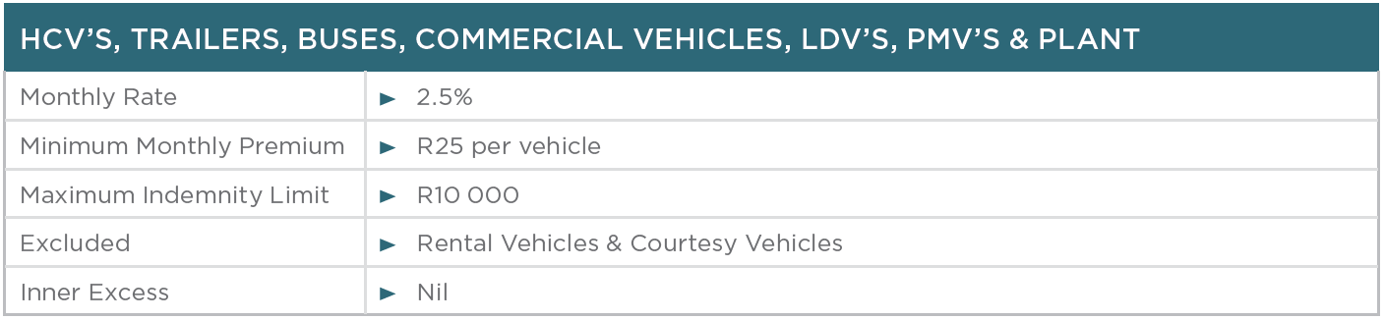
5. Windscreen Excess Reducer
  This section insures your standard Windscreen excess which is payable in terms of your Underlying Insurance Policy limited to the Sum Insured stated in this Policy Schedule and the maximum sum insured stated below.
Specific Conditions
1. In terms of the Insured Vehicles the policy is limited to the Sum Insured as stated subject to maximum Sum Insured per event of;
(a) Heavy Commercial Vehicles, Trailers, Buses, Commercial Vehicles & Plant – R10, 000
(b) Private Motor Vehicles & LDV’s – R 5 000
2. Less the Inner excess as stated in the Policy Schedule and/or as noted on endorsement on Policy Schedule.
3. If non-standard excesses are applied by Underlying Insurers, inner excess may vary
Specific Exclusions
The Underwriter shall not be held liable for:
1. Towing & Recovery Costs are excluded.
Any additional excesses are excluded unless Insured and noted on Policy Schedule.
3. Windscreen claims reported more than 30 days after date of loss.

Slide 14
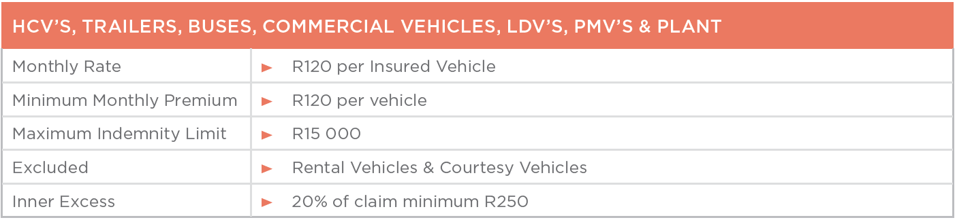
6. Windscreen Comprehensive Cover
  This section insures the repair or replacement of the windscreen damage on your specified Insured Vehicle, NOT the excess reducer section.
Specific Exclusions
The Underwriter shall not be held liable for:
1. Loss or damage to any vehicle lights or mirrors or for any extras, i.e. Window safety shield clear, tint or signage.
2. Loss or damage to any auto glass if such glass is damaged whilst any extras as stated in point 1 above are being fitted.
Side glass cover for busses are excluded.
Specific Conditions
1. Windscreen claims must be reported within 30 days of loss/damage.
2. In terms of the Insured vehicles, this section is limited to R 15 000 any one loss.

Slide 15

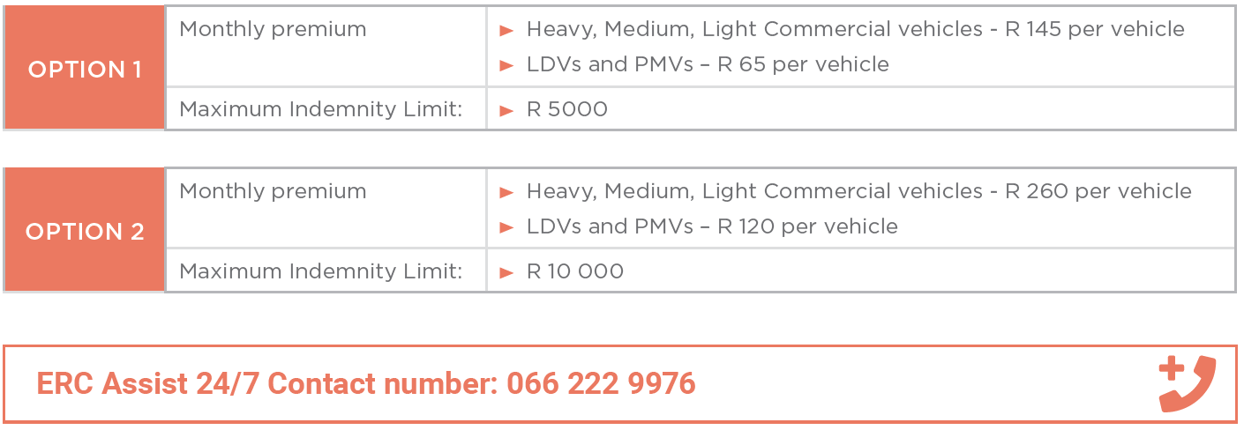
7. ERC Commercial Roadside Assist
  ERC Commercial 24/7 Assist – Roadside Assistance and Accident Management for Commercial Vehicles - (Heavy, Medium & Light Commercial vehicles, LDV’s, PMVs insured on any commercial lines policy)
  ERC Assist Contact Centre provides complete peace of mind in the event of a roadside incident. To ensure you benefit from the service provided by this product call the Assist line in the event of all Roadside emergencies and/or accidents and a consultant will assist and direct you.
Important Note:
  No Transporter or Heavy Haulage clients can be accommodated under this product.

Slide 16
7. ERC Commercial Roadside Assist
Cover provided under this policy:
Accident Management & Towing (Covered to the nearest repairer– Maximum cover of R 5000 (Option 1) or R 10 000 (Option 2) per incident) Provides the following cover and services in the event of an accident:
Rapid deployment of approved service providers to an accident scene and the monitoring and coordination of all activities on the scene.
On-scene accident investigation and reconstruction reports if required supported by all documents and activities recorded which we then provide in the form of a comprehensive case file.
Tow in service and costs covered to the nearest approved repairer, storage facility or repair centre in the event of accidental damage where the vehicle is not drivable and Incidents other than an accident or mechanical/electrical breakdown, rendering the vehicle un-drivable or un-roadworthy.
Mechanical & Electrical Breakdown Towing
Should the insured vehicle and/or trailer(s) become disabled as a result of mechanical or electrical breakdown and a technician that was dispatched cannot repair same, the vehicle and/or trailer(s) will be towed to the nearest service/repair facility not exceeding a radius of
200 kilometres from the scene of the incident limited to the Republic of South Africa.
Note: Only Mechanical and Electrical Components on the Rolling Chassis and/or Drive Line are covered.
Flat Tyre Assistance (Callout fee up to R 1000 per incident)
Assistance will be provided in the event of a flat tyre with a spare tyre to replace it with. The callout fee will be covered up to R1000 per incident and does not include the following:
The cost or delivery of a replacement tyre
Cost of the towing if the tyre change was unsuccessful (towing can be arranged, but the client will be liable for any additional costs)
*Should the spare tyre not be serviceable, or no lock nut key is provided, the vehicle will be towed to the nearest repairer up to R1000 per incident. Any costs exceeding this amount will be for your own account.

Slide 17
7. ERC Commercial Roadside Assist
Cover provided under this policy:
Flat Battery Assistance (Callout Fee covered up to R 1000 per incident)
If a battery failure occurs, a jump start will be provided to start your vehicle
Any additional costs for travel, parts and labour will be for your own account.
Battery not included.
Locksmith Assistance (Callout Fee covered up to R 1000 per incident)
If your keys are locked inside the vehicle, assistance will be provided to gain entry into the vehicle.
The costs for travel and labour in excess of R1000 will be for your own account
Recovery/Winching Assistance (Callout Fee covered up to R 1000 per incident)
Provide assistance in extracting the vehicle when stuck in a ditch and such locations is within 50 meters of a paved road or
highway.
Covered up to a maximum of 1 hour per vehicle per incident.
This benefit does not cover extraction when driving a vehicle off-road or unpaved highway.
Goods in Transit (GIT) Recovery & Management – Provides the following in the event of an accident:
Rapid deployment of nominated and approved service providers, non-hazardous and hazardous clean-up teams to an accident scene and the monitoring and co-ordination of all activities on the scene.
Repacking and salvaging of the load to minimize the loss and overall cost of the incident.
Dispatching security personnel to protect cargo in high-risk areas and situations.

Slide 18
7. ERC Commercial Roadside Assist
Cover provided under this policy:
Hi-Jacking Management – Provides the following services in the event of a Hi-Jacking situation:
Immediate deployment of response teams and authorities to the last known location of a hi-jacked vehicle.
Constant communication between response teams, investigators and tracking companies.
Continuous monitoring and co-ordination of all activities until the vehicle has been recovered.
Important Note:
  GIT Recovery & Management and Hi-jacking Management are services only, no cover afforded under this benefit.
  ERC Call centre will only provide assistance to the client and must get approval from the underlying Insurer before any vehicle can be towed or GIT can be cleaned up. All costs to be billed to the underlying Insurer. No theft cover afforded under these benefits.

Slide 19
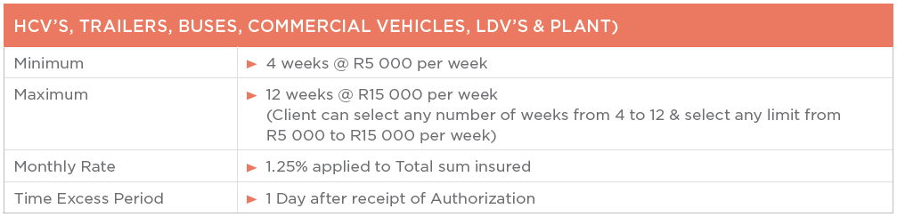
8. Loss of Use
  This section insures your Loss of Income of your Insured Commercial Vehicle following an Insured event of Own Damage or Total Loss (including Theft/Hijack) which is payable in terms of your Underlying Policy, limited to the Sum Insured/daily pro-rata benefit as stated in the Policy Schedule whilst having repairs effected within a reasonable period (solely determined by ERC) following an Insured event.
Important Notes:
  Mechanical and electrical breakdown excluded.
  This cover will commence from the date of the Authorization of repairs minus the 1 day Time Excess period.
  The indemnity period will expire on date of completion of authorized repairs or on the day the Agreement of Loss/Total Loss Release/Tender of Settlement is forwarded from the underlying Insurer to the Insured.
  If being repaired, cover will only be applicable whilst the Insured Vehicle is in the custody of a registered member of the Motor trade, who is an Underlying Policy approved collision damage repairer.
  Tracking reports may be requested in the event of a claim.

Slide 20
8. Loss of Use
Specific Conditions
1. If being repaired cover will only be applicable whilst the Insured Vehicle is in the custody of a registered member of the motor trade, who is an Underlying Insurer approved collision damage repairer.
2. Maximum benefit of R120 000 any one event in total, or
(a) R15 000 per week, or
(b) 12 weeks in total
3. After the deduction of the time excess as defined in the Policy Schedule, this cover will commence the following day from the date of authorization of repairs by the Underlying Policy Insurer.
4. The indemnity period will expire on date of completion of authorized repairs or on the day the Agreement of Loss/Agreed Total Loss Release/Tender of Settlement is forwarded from Insurer onto Insured.
5. Any indemnity amount will only become applicable if the Insured is unable to use the Insured Vehicle in the opinion of ERC prior to the commencement of repair following a loss or accident giving rise to a claim in terms of the Underlying Insurance Policy.
6. The Insured event must be the subject of an indemnifiable claim in terms of the Underlying Policy.
7. Should the Insured Vehicle(s) be declared a total loss or stolen or hijacked & not recovered in terms of the Underlying Policy whichever occurs first, but in any event not exceeding:
8. The limit purchased per the Policy Schedule up to a maximum of 8 / eight weeks in total if the vehicle(s) is repaired,

Slide 21
8. Loss of Use
Specific Conditions (continued)
9. The limit purchased per the Policy Schedule up to a maximum of 6 / six weeks in total if the vehicle(s) was declared a total loss or stolen or hijacked and not recovered. Any amount payable shall only commence after the expiry of the Time Excess as defined.
(a) A three day Time Excess after authorization of repairs to apply to Sum Insured up to R60,000
(b) A five day Time Excess after authorization of repairs to apply to Sum Insured up to R120,000
10. If a second claim occurs on the same vehicle(s) within a 12-month cycle, the time excess period will be 15 days and on a third claim within a 12 month cycle on the same vehicle(s), the excess period will be 20 days.
11. The time excess period will apply over and above any other excess payable under this Policy in connection with the same incident.
12. Any claims for Loss of Use or Total Loss per vehicle arising within the first 60 days of cover will result in a 21 day excess period being applied.
13. Combined claims limit in respect of Own Damage Excess and Loss of Use:
14. An overall combined gross claims limit of R350, 000 per incident is applicable when benefits under all sections are claimed.
Specific Exclusions
1. No claim will be processed for downtime caused by mechanical and/or electrical breakdown.
2. No claim will be paid unless proof is submitted that the Underlying Company has indemnified the Insured for the said Insured event.

Slide 22
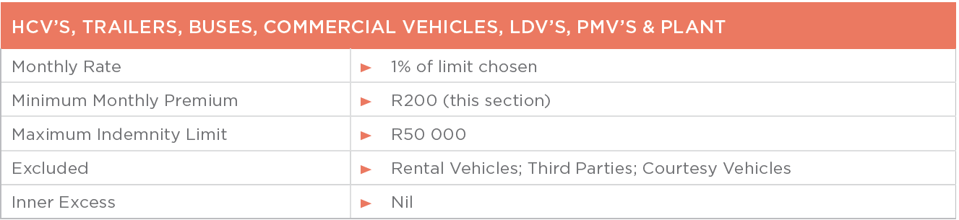
9. Cross Border Towing & Recovery
  Where the insured vehicle is involved in an accident outside the borders of the RSA and sustains damage which is insured in terms of sub-section A of the policy and which renders it undriveable, the company will pay the actual costs of recovery and towing which have been incurred to repatriate the insured vehicle to the RSA, provided that the indemnity afforded by this section does not exceed R50,000, and provided that the cover under this section only pays for the costs incurred in getting the insured vehicle to the South African side of the border. Once the insured vehicle is on the South African side of the border all cover under this section ceases.
Specific Exclusion
The company shall not be liable to pay for the cost of any damages which may occur to the vehicle during repatriation to the South African side of the border and/or the cost of any duties payable to the authorities.

Slide 23
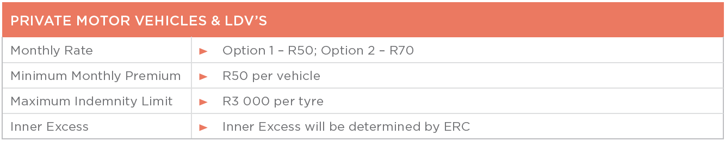
10. ERC Tyre Cover
  In the event of accidental damage to a tyre caused by sudden braking, cuts, punctures by foreign objects or bursts, the insurer will indemnify the Insured for the cost of repair or replacement of a tyre including balancing, provided that the indemnity is based on the percentage of unused tread left on the tyre.
The Insurer will reimburse the Insured the amount on the invoice relating to the purchase or repair of tyres, less any wear and tear on the tyre at the time of an event that may result in a claim. Maximum indemnity is R2 000 per tyre (Option 1) or R 3 000 (Option 2), less any wear and tear/worn tread. Maximum liability per claim/event is R4 000 (Option 1) or R6000 (Option 2).
Specific Condition
This policy is limited to two claims per year, or one claim if two tyres are replaced in one incident. All claims must be reported to the
ERC call centre on 011 453 9543 before any replacement of damaged tyre(s) may be done.
No claim(s) will be paid if the client replaces tyre(s) without authorisation from ERC.

Slide 24
10. ERC Tyre Cover
Specific Exclusions
The Insurer will not be liable to pay for any loss or resultant damage:
to tyres on any heavy commercial type vehicle or fare paying transport vehicles;
caused to tyres by safety devices, or built-in safety mechanisms built into or fitted onto tyres;
to flat tyres, - where the tyre cannot be repaired as a result of a normal puncture;
caused to tyres as a result of driving while the tyre(s) are deflated; (Punctured tyre(s)-: tyre(s) that could have been repaired, if not been driven on while punctured.)
to tyres that have a tread depth of less than 1mm at any point;
to tyres fitted to a vehicle used for racing, pace setting, speed testing, reliability trials, hire or reward, off-road activities, dispatch or courier services, or driving tuition;
caused by or resulting from an accident involving the motor vehicle on which the tyres were fitted;
to threads, i.e. tyres that have been refitted with rubber threads;
tyres still covered under a supplier or manufacturer’s warranty or guarantee period;
from, or any liability arising from faulty manufacturing or fitment;
to the vehicle resulting from an event covered by this policy;
to rims, mags or any safety devices fitted on or in the tyre;
or liability to third parties, or third party property damage;
Tyre Insurance Tread & Indemnity Limits
Our indemnity limits will be calculated as follows
1mm left on the tyre – 12.5% of the cost of the tyre
2mm left on the tyre – 25% of the cost of the tyre
3mm left on the tyre – 37.5% of the cost of the tyre
4mm left on the tyre – 50% of the cost of the tyre
5mm left on the tyre – 62.5% of the cost of the tyre
6mm left on the tyre – 75% of the cost of the tyre
7mm left on the tyre – 87.5% of the cost of the tyre
8mm left on the tyre – 100% of the cost of the tyre

Slide 25
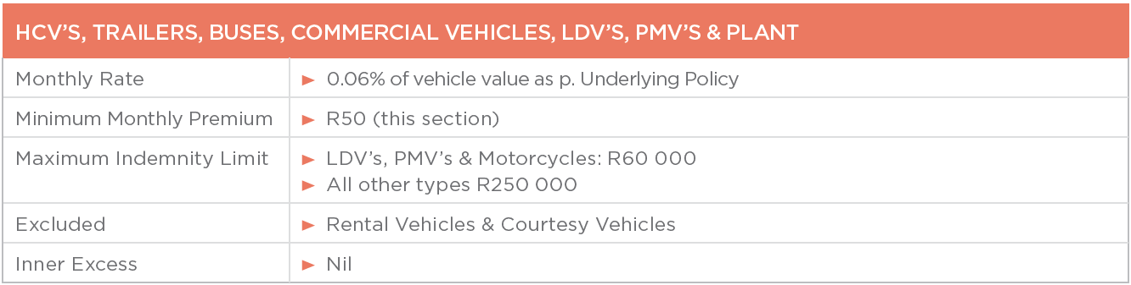
11. Credit Shortfall
  This section insures you for the shortfall arising following a total loss settlement per the Underlying Insurance Policy; this
  amount is calculated as the difference between the retail value (as stipulated in the TransUnion Dealers Guide) and the
  Statutory Settlement Balance in the applicable Credit Agreement as defined.
Specific Exclusions
Excluding any amount not directly related to the financing of the purchase / lease of the Insured Vehicle and its accessories such as but not limited to insurance premiums, maintenance agreements, warranty agreements and the like.
Excluding any arrear amounts, interest on arrears or any other fees, such as but not limited to maintenance fees and any residual payment due under the final instalment and any re-financed payments.
Inner Excess will be nil and or as noted on Policy Schedule.
If a 0% deposit was paid when the finance agreement incepted and/or the finance term exceeded 60 months, an alternative rate will apply.

Slide 26
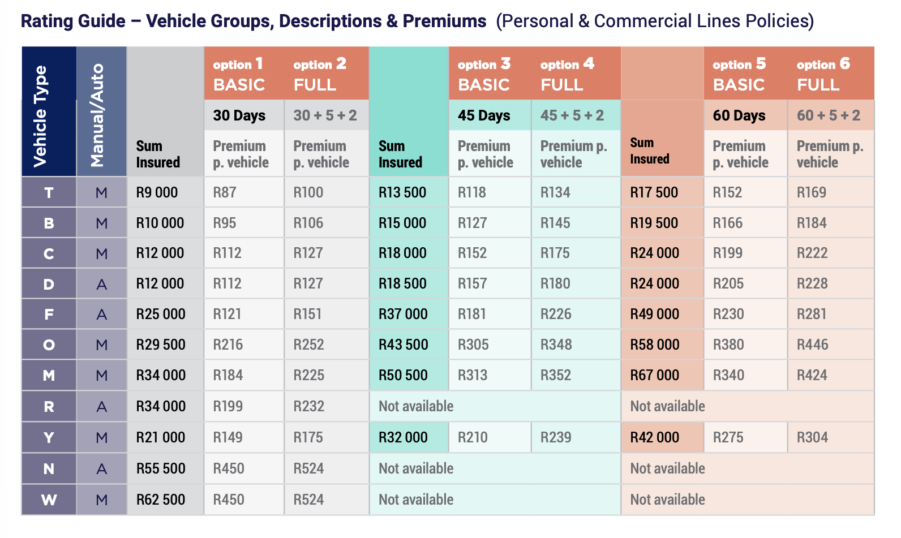
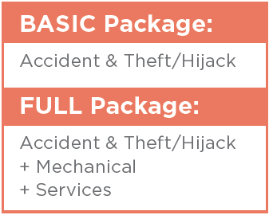
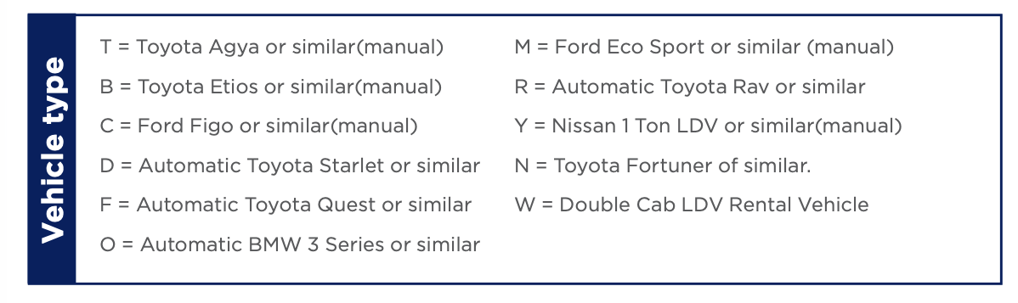
12. Car Hire
  ERC will pay the actual Car Hire charges including the cost of delivery if the insured vehicle is unusable or is being repaired following loss or damage covered under the underlying motor section or while the vehicle remains uncovered following theft, subject to availability, in terms of the selection of the Group car as shown in the schedule.
  If selected, ERC will also pay for a period of 5 days after a mechanical breakdown of the vehicle and for two days’ rental for routine servicing of the Insured vehicle.

Slide 27
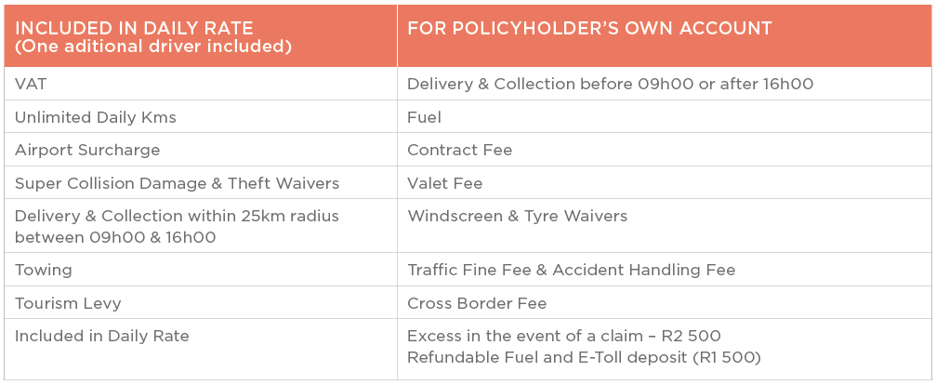
12. Car Hire
When will we arrange Car Hire?
Insured Vehicle Stolen or Hijacked - We will arrange car hire upon receipt of instructions accompanied by copies of the claim forms from the insurer.
Insured Vehicle damaged but drivable - Provided we have received instructions and copies of claim forms from the Insurer, we will arrange car hire as soon as the insured vehicle has been delivered to an approved panel beater
Insured Vehicle damaged and not drivable - Provided we have received instructions and copies of claim forms from the insurer, we will arrange car hire as soon as the insured vehicle has been towed.
Mechanical Breakdown (If cover is included) - Upon receipt of instructions accompanied by the mechanical breakdown claim form from the insurer, we will provide the insured with a hired vehicle for a period of up to 5 days whilst the insured vehicle is not in the insured’s possession.
Routine Services (Two claims per annum and if cover is included) - Upon receipt of instructions accompanied by written confirmation from an approved motor dealer confirming the service date, we will provide the insured with a hired vehicle for a period of 2 days, twice per annum, whilst the insured vehicle is not in the insured’s possession

Slide 28
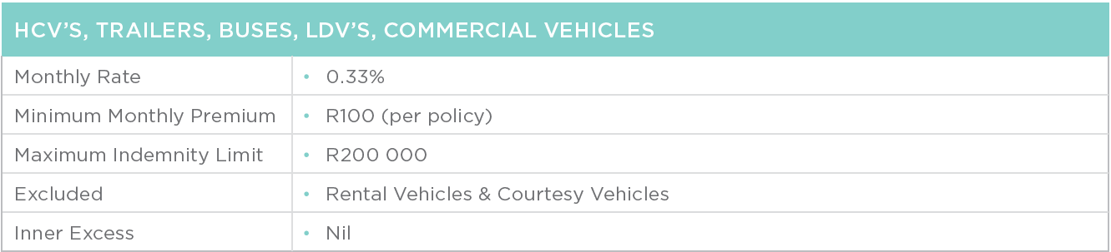
13. Goods in Transit (GIT) – Basic Excess Reducer
  This section covers your specified vehicle’s GIT Basic excess applicable, which is calculated and payable on your Underlying Insurance Policy limited to the Sum Insured and Specified excesses as stated in the Policy Schedule and the maximum Sum Insured.
Important Note:
  Cover can be extended to include Tarps, Ropes, Chains, Debris removal etc.
Specific Exclusions
1. No cover will apply in the event of aggregate deductibles.
2. Insured Cargo Exclusions: Antiques, antiquities of any description, arms, ammunition, bank and treasury notes, bullion, cash, mobile telephones and accessories, copper, deeds, designs, documents of any description, explosives, film, gold, or silver articles, used household goods and personal effects, jewellery, liquor (other than wine or beer), live animals, motor vehicles of any description, plans, precious metals or stones, pre-paid phone cards or vouchers, specie, stamps, tickets, tobacco products and traveller's cheques unless specifically included in the policy schedule.

Slide 29
13. Goods in Transit (GIT) – Basic Excess Reducer
Specific Conditions
1. Maximum limit of Indemnity – R200 000 per event.
2. Limited to Cost Price of goods to the owner of the goods and/or replacement value and/or market value whichever is the lesser, at time of loss.
3. There must be in force a valid Underlying Transit Policy with a registered South African insurer covering the risks insured, at the time of loss.
4. If liability is declined in terms of the Underlying Transit Policy, then indemnification of this policy will similarly be declined.
5. Any condition, warranty or exclusion applicable to the Underlying Transit Policy will similarly be applicable to this cover.
6. This policy will only respond where there has been a legitimate non-hijack or hijack claim on the Underlying Transit Policy and such indemnity has been paid to the Insured by the Insurer, less the excess applicable in terms of the Underlying Transit Policy.
7. Insurers reserve the right to call for proof of payment of the loss by the Insurers of the Underlying Transit
Policy, including copies of the Insurers claim adjustment, agreement of loss form or a full copy of the Underlying Transit Policy.
8. In the event of a recovery of any hijacked, stolen or damaged goods / salvage being made, Insurers reserve the right to be reimbursed for their rateable proportion of any such recovered goods.
9. Insurers are entitled to charge a re-instatement premium equivalent to the monthly premium, following an Insured loss.
10. In the event of a recovery of any damaged goods / salvage being made, Insurers reserve the right to be reimbursed for their rateable
proportion of any such recovered goods.
11. Inner Excess: Nil, unless an endorsement is noted on Policy Schedule
12. No additional excess will be covered unless agreed on and endorsement is noted on Policy Schedule noting same.

Slide 30
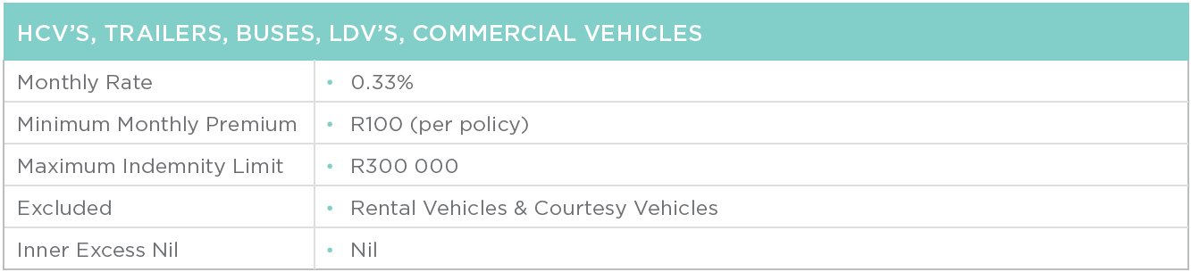
14. Goods in Transit (GIT) – Theft/Hijack Excess Reducer
  This section covers your specified vehicle’s GIT Theft/Hijack excess applicable, which is calculated and payable on your Underlying Insurance Policy limited to the Sum Insured and Specified excesses as stated in the Policy Schedule and the maximum Sum Insured.
Important Note:
  Cover can be extended to include Tarps, Ropes, Chains, Debris removal etc.
Specific Exclusions
1. No cover will apply in the event of aggregate deductibles.
2. Insured Cargo Exclusions: Antiques, antiquities of any description, arms, ammunition, bank and treasury notes, bullion, cash, mobile telephones and accessories, copper, deeds, designs, documents of any description, explosives, film, gold, or silver articles, used household goods and personal effects, jewellery, liquor (other than wine or beer), live animals, motor vehicles of any description, plans, precious metals or stones, pre-paid phone cards or vouchers, specie, stamps, tickets, tobacco products and traveller's cheques unless specifically included in the policy schedule.

Slide 31
14. Goods in Transit (GIT) – Theft/Hijack Excess Reducer
Specific Conditions
1. Maximum limit of Indemnity – R300 000 per event.
2. Limited to Cost Price of goods to the owner of the goods and/or replacement value and/or market value whichever is the lesser, at time of loss.
3. There must be in force a valid Underlying Transit Policy with a registered South African insurer covering the risks insured, at the time of loss.
4. If liability is declined in terms of the Underlying Transit Policy, then indemnification of this policy will similarly be declined.
5. Any condition, warranty or exclusion applicable to the Underlying Transit Policy will similarly be applicable to this cover.
6. This policy will only respond where there has been a legitimate non-hijack or hijack claim on the Underlying Transit Policy and such indemnity has been paid to the Insured by the Insurer, less the excess applicable in terms of the Underlying Transit Policy.
7. Insurers reserve the right to call for proof of payment of the loss by the Insurers of the Underlying Transit Policy, including copies of the Insurers claim adjustment, agreement of loss form or a full copy of the Underlying Transit Policy.
8. In the event of a recovery of any hijacked, stolen or damaged goods / salvage being made, Insurers reserve the right to be reimbursed for their rateable proportion of any such recovered goods.
9. Insurers are entitled to charge a re-instatement premium equivalent to the monthly premium, following an Insured loss.
In the event of a recovery of any damaged goods / salvage being made, Insurers reserve the right to be reimbursed for their rateable
proportion of any such recovered goods.
11. Inner Excess: Nil, unless an endorsement is noted on Policy Schedule
12. No additional excess will be covered unless agreed on and endorsement is noted on the Policy Schedule noting same.

Slide 32
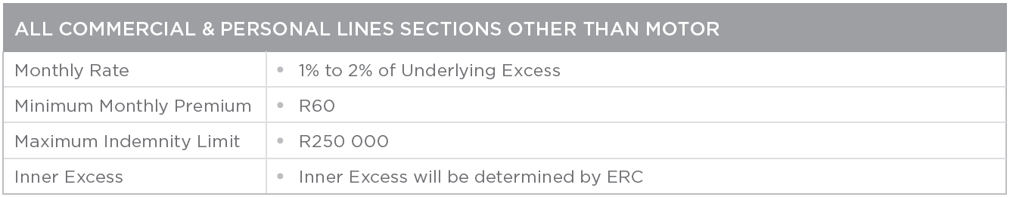
15. ERC Non-Motor Excess Reducer
  This product covers any Non-Motor excess as described in your ERC Policy Schedule which is payable in terms of your Underlying Insurance Policy limited to the Sum Insured stated in the ERC Policy Schedule and the maximum sum insured stated in your ERC Policy Wording.
  Commercial Lines sections that we can provide Excess Reducer cover on: Fire, Buildings Combined, Office contents, Electronic Equipment, Theft, Money, Glass, Fidelity, Business All Risks & Accidental Damage.
  Personal Lines sections that we can provide Excess Reducer cover on: Houseowners (Buildings), Householders (Contents) & All Risks.
  These rates are a guide only. Please refer all quotes to ERC for a formal quote.
Specific Exclusions
The Underwriter shall not be held liable if:
Proof of settlement has been received from the Underlying Policy Insurer.
The Underlying Insurer has refused your claim for an event.

Slide 33
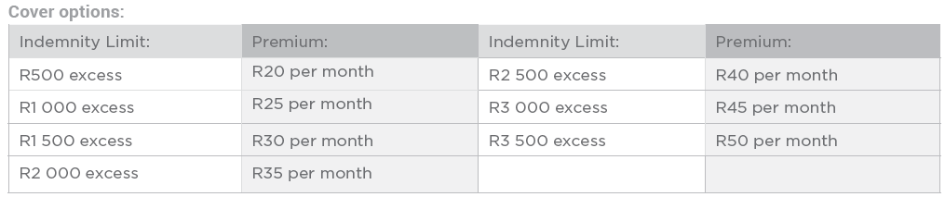
16. ERC Geyser Excess Waiver
  (Personal & Commercial Lines Policies)
  This section covers your geyser excess which is payable in terms of your Underlying Insurance Policy limited to the Sum Insured stated in the ERC Policy Schedule and the Indemnity Limited stated below.
Important Notes
There must be a valid Comprehensive Underlying policy in place.
This is a stand-alone product

Slide 34
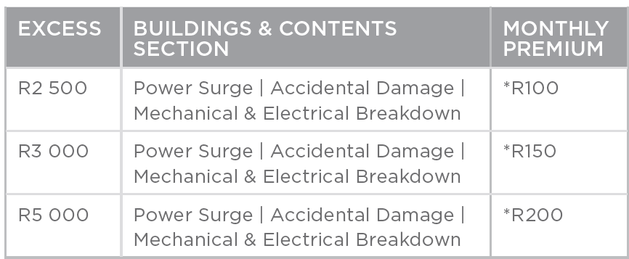
17. ERC Protector
  (Personal & Commercial Lines Policies)
  This product covers your excess on Power Surge, Accidental Damage and Mechanical & Electrical Breakdown on Buildings and Contents as described in your ERC Policy Schedule which is payable in terms of your Underlying Insurance Policy limited to the Sum Insured stated in the ERC Policy Schedule.
Important Notes
There must be a valid Comprehensive Underlying policy in place.
*Premiums are subject to claims history.

Slide 35


T) +27 11 453 9543
C) +27 76 787 3894
E) info@excessrisk.co.za
www.excessrisk.co.za
Suite W002, Midlands Office Park West, Mountain Quray Road,
Midstream Estate Centurion,
Gauteng
1692
Excess Risk Consultants is an Authorised Financial Services Provider | FSP No: 51829
Underwritten by Old Mutual Insure Limited | FSP No: 12

